Slide 1
Analyzing Amazon Sales Data: Insights into E-commerce Sales Trends
Exploring Key Metrics and Sales Patterns in the Amazon Ecosystem

Slide 2
Introduction
This project focuses on analyzing sales data from Amazon to uncover key trends and insights within the e-commerce domain. By examining sales patterns over various timeframes, we aim to identify the factors driving revenue and customer behavior.
The insights derived will support data-driven decision-making for optimizing sales strategies. Our analysis will explore critical metrics such as total revenue, units sold, and average order value.

Slide 3
Details of Data (Key Attributes)
Order Date
Product Category
Sales Revenue
Units Sold
Customer ID

Slide 4
Main KPIs
Total Revenue: The overall sales revenue generated during the analyzed periods.
Units Sold: The total number of products sold across different categories and timeframes.
Average Order Value (AOV): The average amount spent per order, calculated as total revenue divided by the number of orders.
Customer Retention Rate: The percentage of repeat customers within a given period.
Sales Growth Rate: The rate at which sales are increasing or decreasing over time.

Slide 5
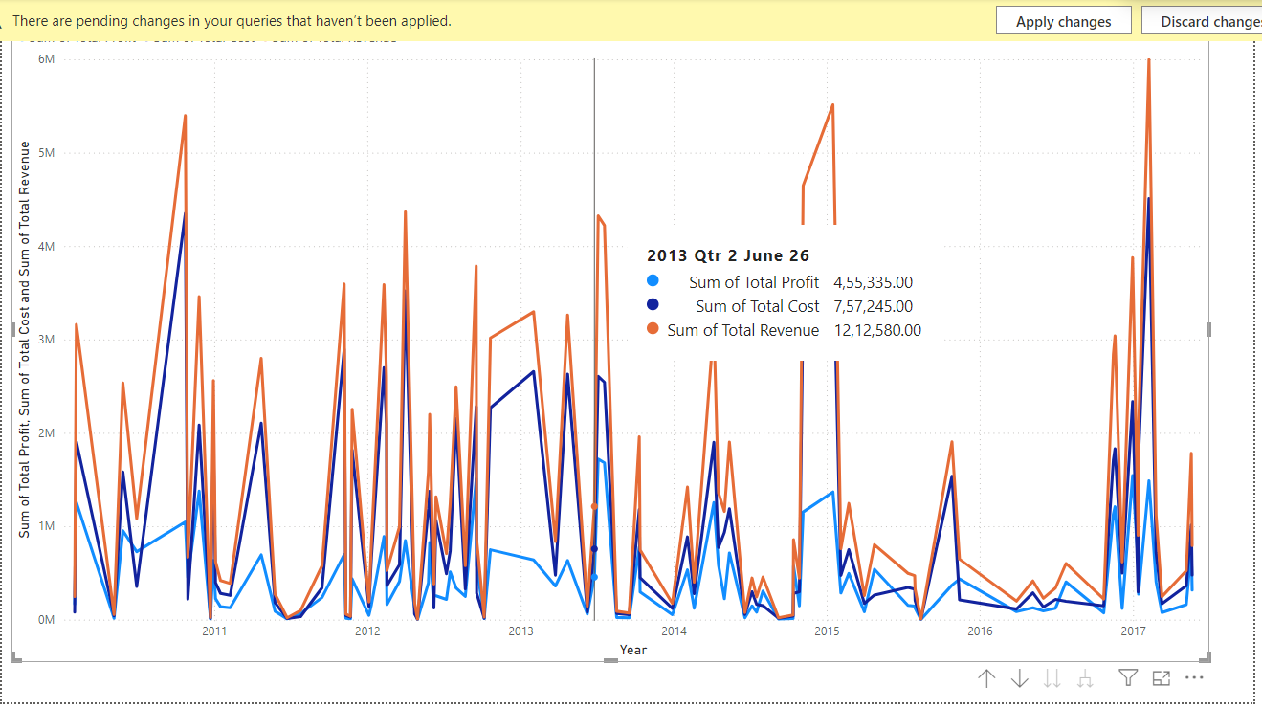
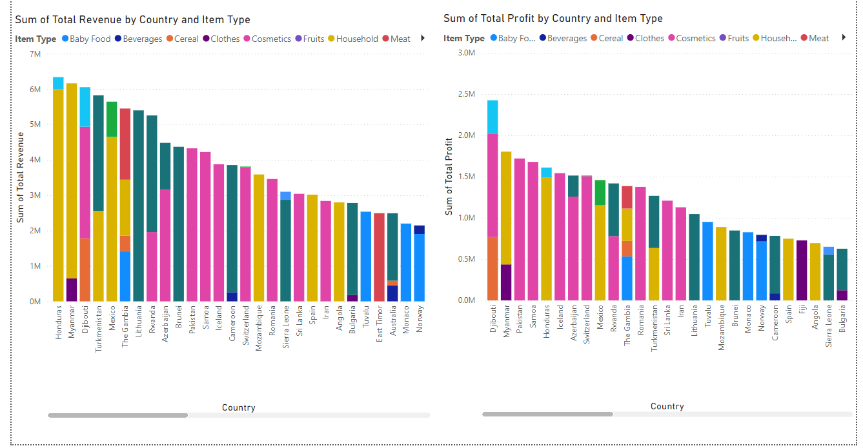
Dashboard

Slide 6
My Design

Slide 7
Thank you

